Slide 1

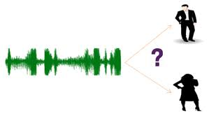
Gender recognition by voice
Ankit Nigam
GCDAI – August batch 2019

Slide 2
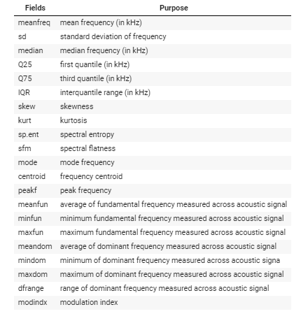

Dataset information
Input features
Target

Slide 3
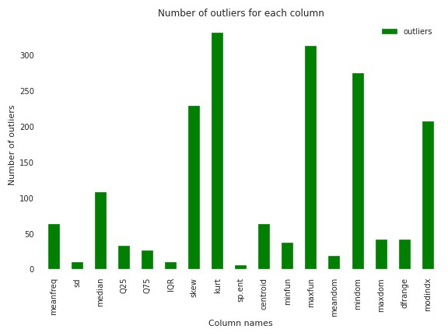
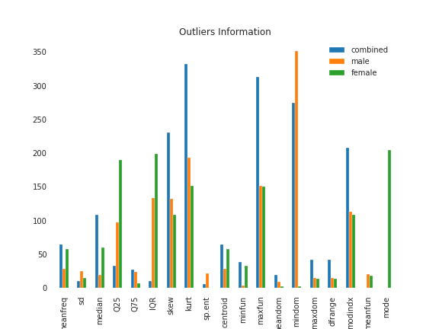
Outlier Information

Slide 4

Data distribution – Kurtosis

Slide 5

Data distribution – Skewness

Slide 6
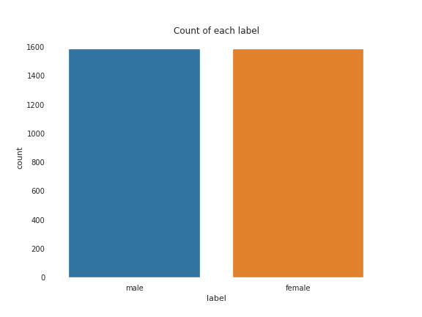
Data distribution – target

Slide 7
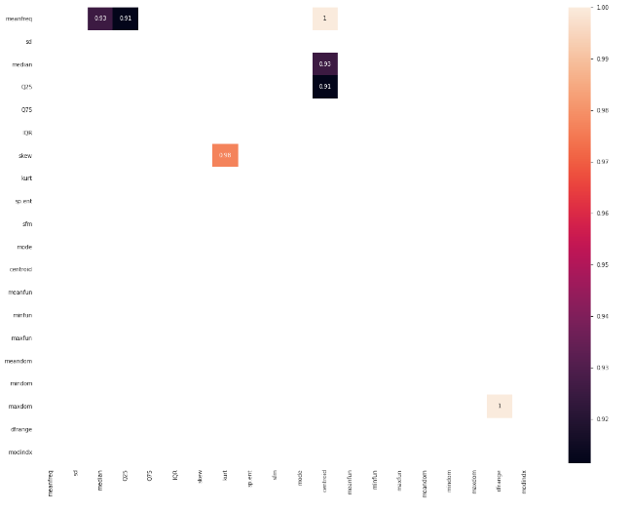
Correlation between columns

Slide 8
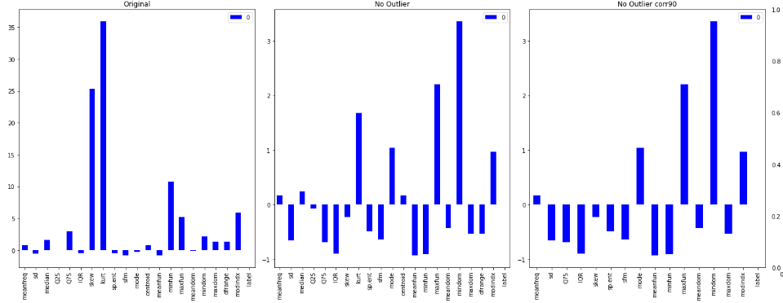
Data distribution after scaling– Kurtosis

Slide 9
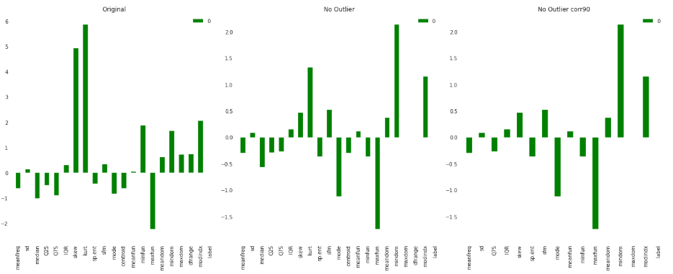
Data distribution after scaling – Skewness

Slide 10
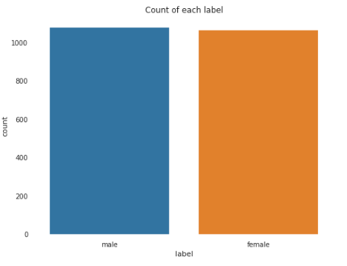
Data distribution after outlier removal – target

Slide 11
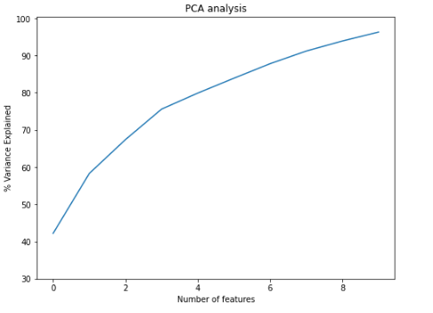
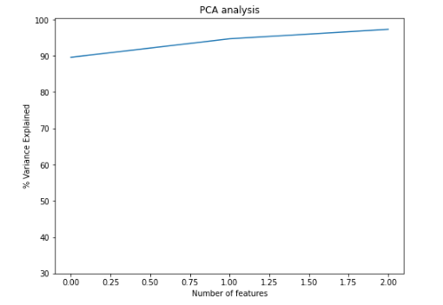
Dimensionality reduction - PCA

Slide 12
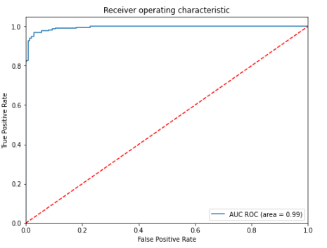
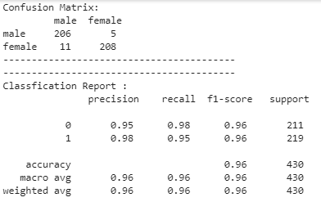
Model Selection using pipeline

Slide 13
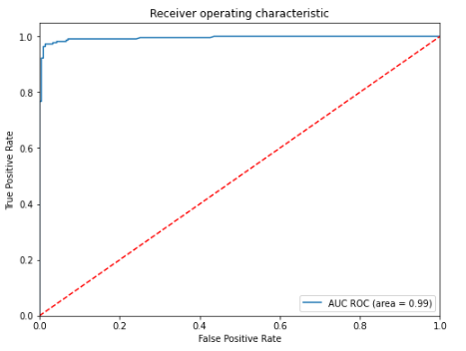
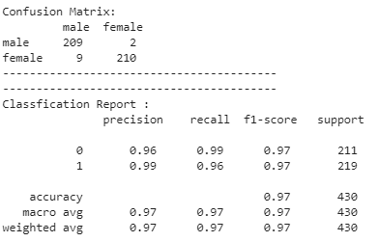
Model Selection using pipeline

Slide 14
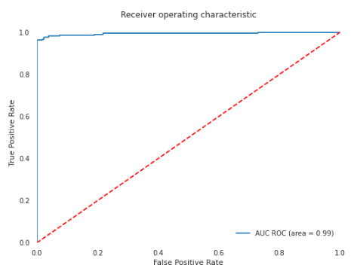

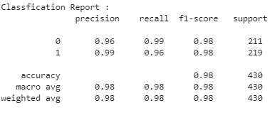
Final Model – Support Vector Classifier

Slide 15
Thank You

